Slide 1
MODELING XR TRAFFIC WITH NS-3
A2
PAULINE BEREAU

Slide 2
SUMMARY
  TASK 1 - INSTALLATION AND BUILD
  TASK 2 - THE 3GPP TR 26.926 STANDARD
  TASK 3 - PROOF OF EXECUTION (WIRESHARK)
  TASK 4.1 - TIMING VERIFICATION (MATH PROOF)
  TASK 4.2 - PACKET SIZE VERIFICATION (MATH PROOF)

Slide 3
INSTALLATION & BUILD
SIMULATOR: NS-3 (VERSION 3.48)
PLATFORM: MACOS
CHALLENGES OVERCOME:
  HOMEBREW MISSING SCRATCH/ DIRECTORY -> BUILT MANUALLY FROM SOURCE
  API DEPRECATION -> REPLACED INSTALL() WITH ASSIGN() FOR IPV4

Slide 4
THE 3GPP TR 26.926 STANDARD

Slide 5
THE 3GPP TR 26.926 STANDARD
  STANDARD: 3GPP TR 26.926 (XR TRAFFIC MODEL)

Slide 6
THE 3GPP TR 26.926 STANDARD
  STANDARD: 3GPP TR 26.926 (XR TRAFFIC MODEL)
  RULE 1 - CONSTANT INTER-ARRIVAL TIME: 16 MS INTERVALS (TO GUARANTEE 60 FPS)

Slide 7
THE 3GPP TR 26.926 STANDARD
  STANDARD: 3GPP TR 26.926 (XR TRAFFIC MODEL)
  RULE 1 - CONSTANT INTER-ARRIVAL TIME: 16 MS INTERVALS (TO GUARANTEE 60 FPS)
  RULE 2 - VARIABLE FRAME SIZE: MODELED AS A TRUNCATED GAUSSIAN DISTRIBUTION

Slide 8
THE 3GPP TR 26.926 STANDARD

Slide 9
THE 3GPP TR 26.926 STANDARD
  GENERATED CUSTOM C++ SCRIPT USING AI

Slide 10
THE 3GPP TR 26.926 STANDARD
  GENERATED CUSTOM C++ SCRIPT USING AI
  DATA GENERATION: CALCULATED VARIABLE FRAME SIZES DYNAMICALLY

Slide 11
THE 3GPP TR 26.926 STANDARD
  GENERATED CUSTOM C++ SCRIPT USING AI
  DATA GENERATION: CALCULATED VARIABLE FRAME SIZES DYNAMICALLY
  FRAGMENTATION: SPLIT LARGE FRAMES INTO PACKETS (~1400 BYTES)

Slide 12
THE 3GPP TR 26.926 GENERATION
  GENERATED CUSTOM C++ SCRIPT USING AI
  DATA GENERATION: CALCULATED VARIABLE FRAME SIZES DYNAMICALLY
  FRAGMENTATION: SPLIT LARGE FRAMES INTO PACKETS (~1400 BYTES)
  PROTOCOL: UDP

Slide 13
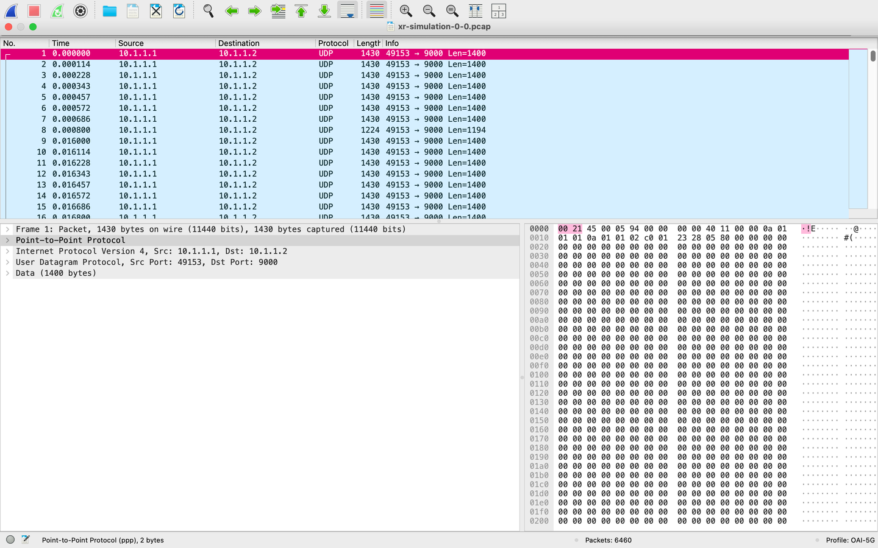
PROOF OF EXECUTION (WIRESHARK)
SOURCE: 10.1.1.1 | DESTINATION: 10.1.1.2 | PROTOCOL: UDP

Slide 14
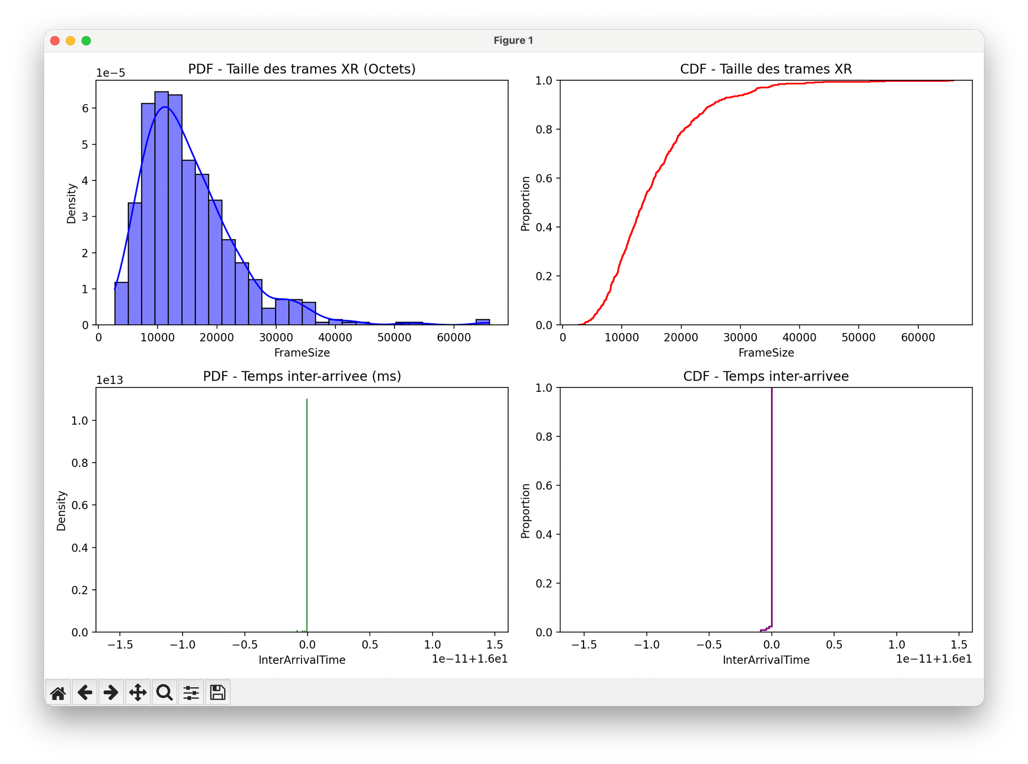
TIMING VERIFICATION
PDF & CDF OF INTER-ARRIVAL TIME

Slide 15

PACKET SIZE VERIFICATION
PDF & CDF OF FRAME SIZE DISTRIBUTION

Slide 16
CONCLUSION

Slide 17
CONCLUSION
→ SUCCESSFULLY COMPILED AND RAN NS-3 ON MACOS

Slide 18
CONCLUSION
→ SUCCESSFULLY COMPILED AND RAN NS-3 ON MACOS
→ ACCURATELY MODELED THE 3GPP TR 26.926 XR STANDARD

Slide 19
CONCLUSION
→ SUCCESSFULLY COMPILED AND RAN NS-3 ON MACOS
→ ACCURATELY MODELED THE 3GPP TR 26.926 XR STANDARD
→ EXTRACTED PCAP AND PLOTTED MATHEMATICAL PROOFS TO VERIFY ACCURACY

